Slide 1

Distance Sensing Robot with Voice Control
Chinmay Galande, Anirudh Arunkumar, Sufiyan Ahmed, Ashwin Milind
ECE 4180 Final Project
Georgia Institute of Technology

Slide 2

Introduction
The robot is able to take voice commands from any android using an app developed with MIT Inventor via bluetooth
Autonomous mode (Say “Autonomous”)
Distance read via the ultrasonic sensor on the front
If an obstacle is detected within ~25cm, it will stop, turn until there is no longer an obstacle, and then start moving forward again.
Speaker “beeps” when moving backwards
LCD shows that it is in Autonomous mode
Voice mode (Say “Bluetooth”)
Drive forward, backward, and turn via voice commands.
LCD shows direction of movement.
Speaker “beeps” when moving backwards

Slide 3
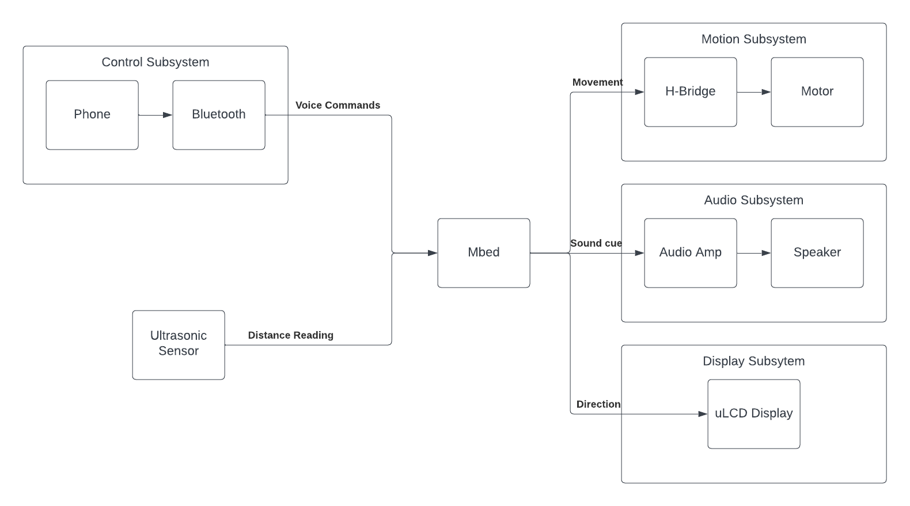
Block Diagram

Slide 4
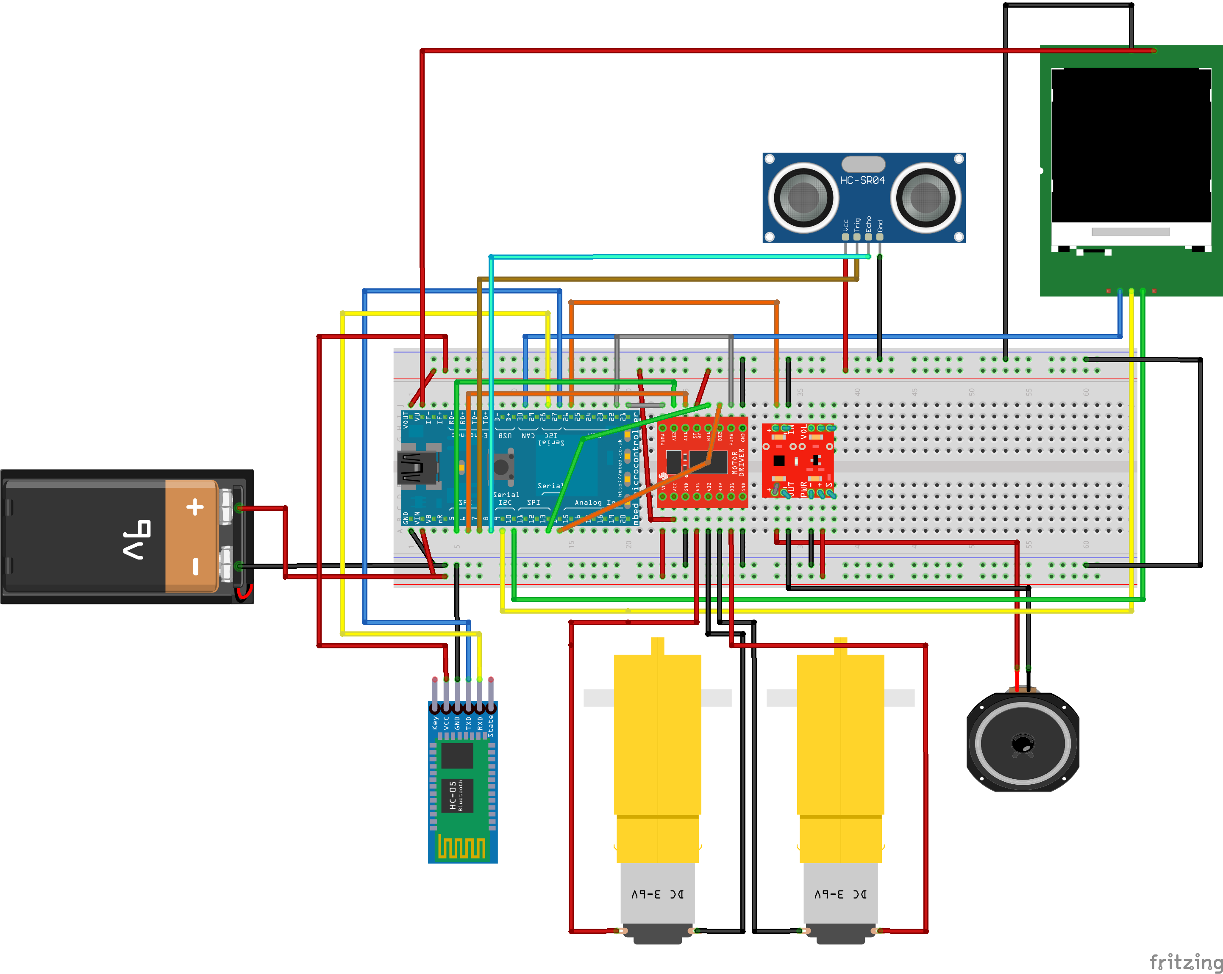
Schematic

Slide 5
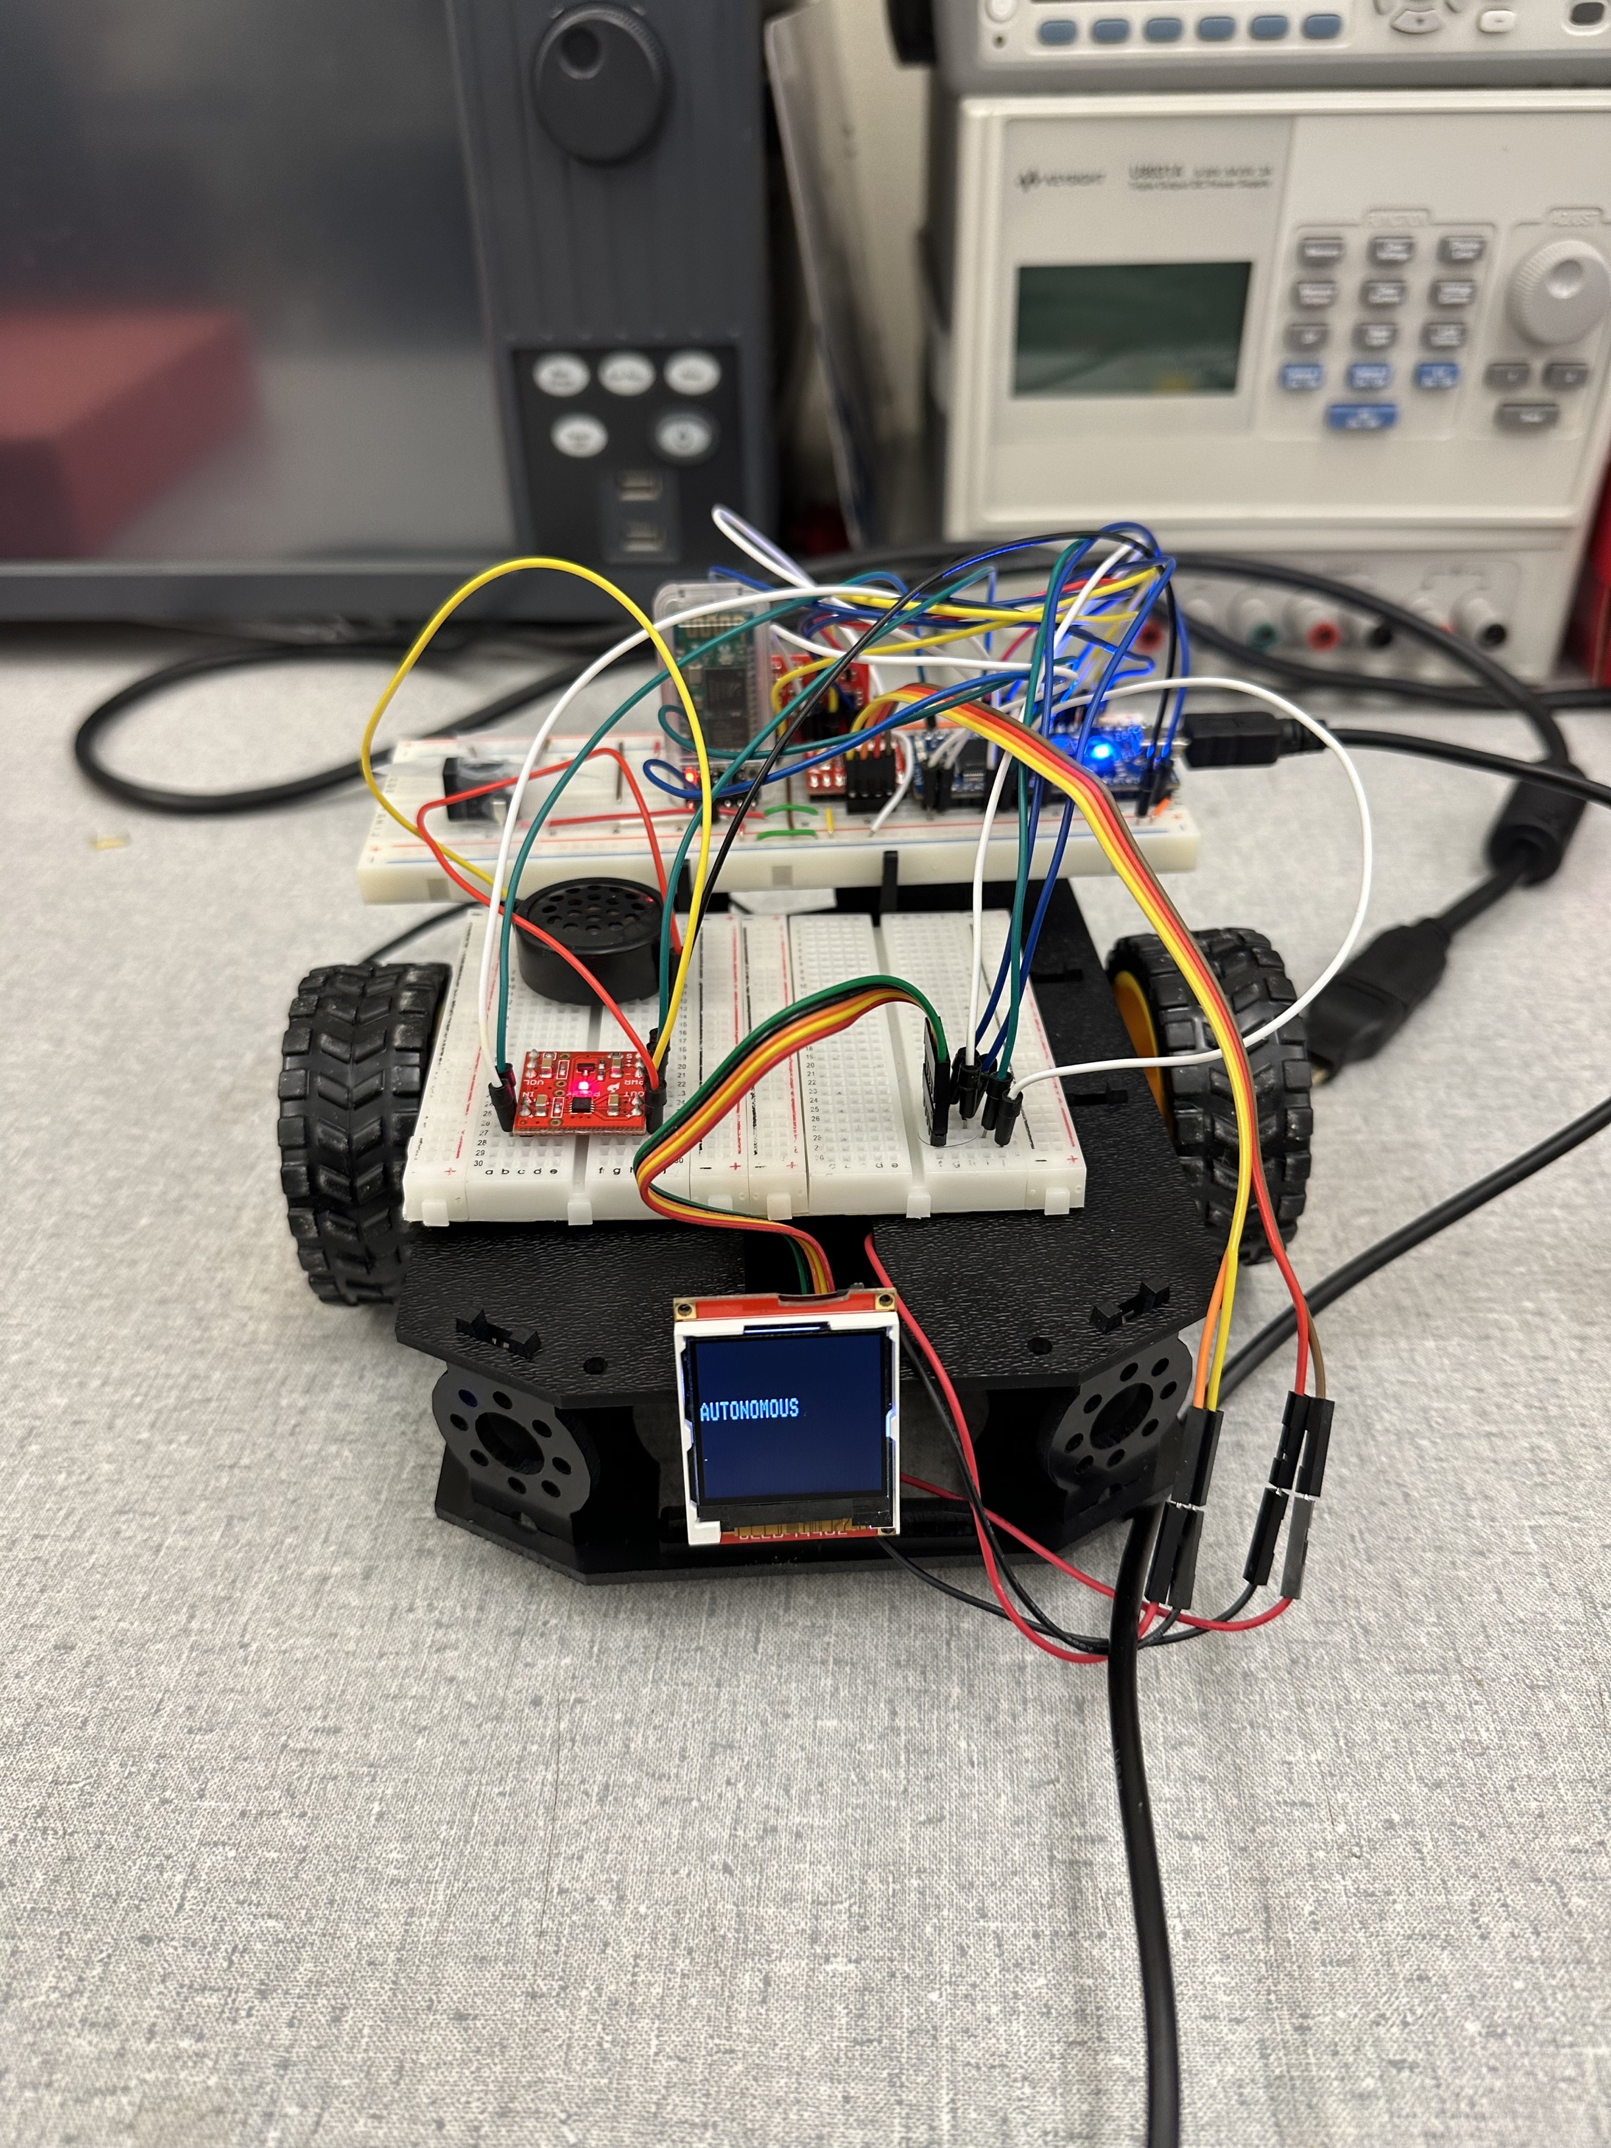
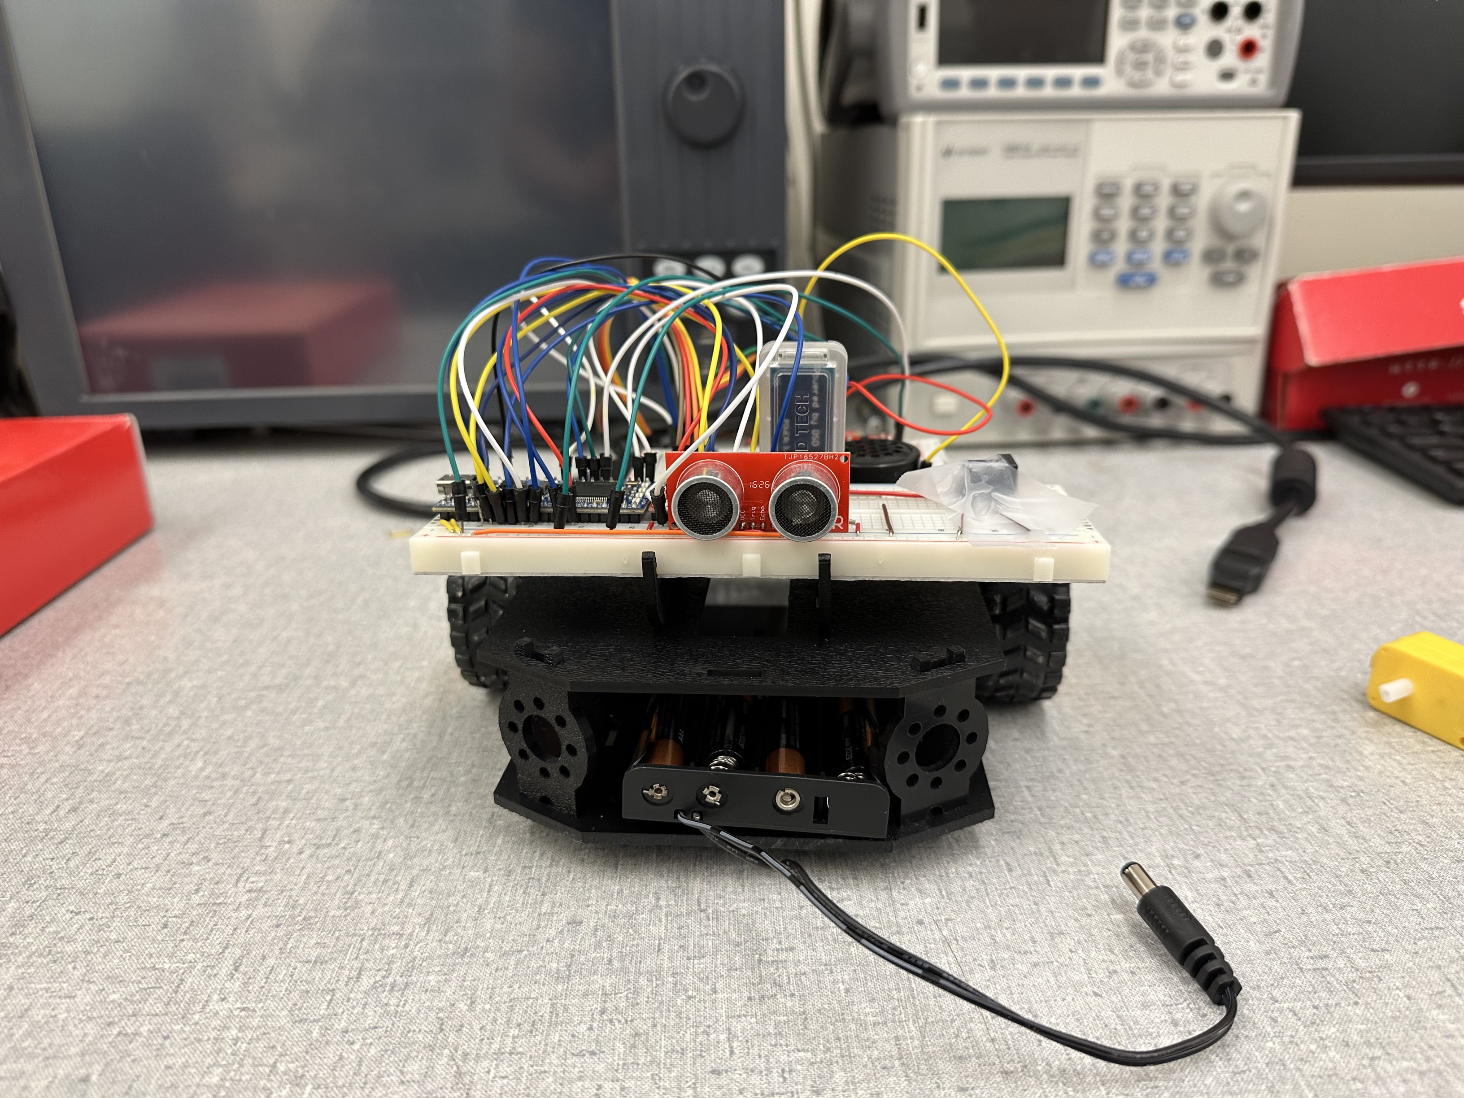
Picture of the Robot

Slide 6
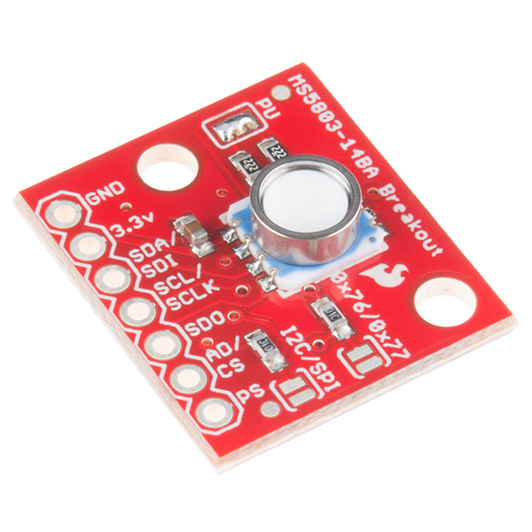
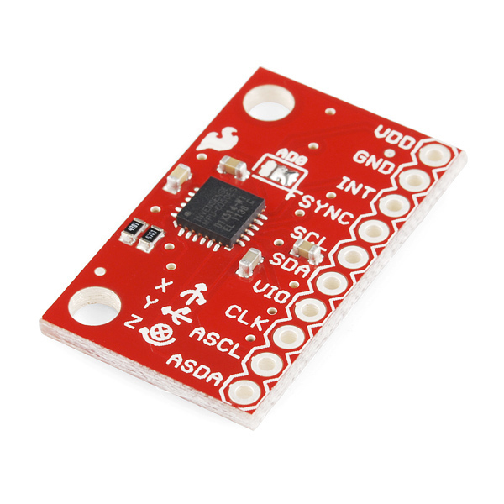
Conclusion & Future Direction

